Slide 1



APSCHE – IBM SKILLSBUILD-EDUNET AI INTERNSHIP PROGRAM Project: Employees Burnout Rate Analysis and Prediction

Slide 2

Student Details :
Name : JANGALA JOE
Email Id : joejangala12@gmail.com
College : KALLAM HARANADHA REDDY INSTITUE OF TECHNOLOGY
College State : ANDHRA PRADESH
Internship Domain : ARTIFICIAL INTELLIGENCE
Project Topic : Employees Burnout Analysis and Prediction

Slide 3
Employees Burnout Analysis and Prediction
Employee Burnout :
Employee burnout is a specific type of workplace stress, where workers feel general dissatisfaction with their work and multiple levels of exhaustion, including mental exhaustion, physical exhaustion and emotional exhaustion.
Causes of burnout :
1. Workload
2. Perceived lack of control.
3. Lack of reward or recognition.
4. Lack of fairness.
5. Environment & Management

Slide 4
Agenda
To develop a Advanced Machine Learning Model to accurately predict the Burnout Rate of Employees.
To Analyse the relations and underlying patterns among different attributes of a employee and burnout rate.
To accurately predict the burnout rate of a new employee.
To use the Modern AI and ML Technologies in predicting the employee burnout rate.

Slide 5
Project Overview
Platform : Google Colab
Language : Python
Libraries : sklearn, pandas, numpy, seaborn, matplotlib, plotly
Machine Learning Algorithm : Random Forest, Adaboost
Dataset : employee_burnout_analysis.xlsx
(Provided Dataset)

Slide 6
Project Overview
In the provided dataset different attributes like Employee ID, Date of Joining, Gender, Mental Fatigue Score, Company Type, Burn rate, Designation, WFH Setup, Resource Allocation are provided.
Target column is the Burn Rate
Using all the remaining columns a model is trained in such a way that it can accurately find the underlying patterns and predict the accurate values for the employee burnout rate column.
To use the provided data to train a Machine Learning Model there is a need to process the raw data and perform several actions like filling out the missing values, changing the data into valid data types , dropping unnecessary columns which won’t be used in training.
Selecting the Right Algorithm :
By the content of the provided data regression algorithms can be used to predict the burnout rate as the values are associated with numbers and continous values.

Slide 7
Steps
Label Encoding:
As some values are strings Label encoding is performed to convert object data type into integer data type and the values are stored in a new labelled columns.
Feature Selection:
Considering the attributes which are necessary in training the model and assigning the target attribute.
Principal Component Analysis:
It is used for the dimensionality reduction of the data.
Data Splitting :
Splitting the dataset into Training Data Set and Test Data Set
Model Implementation:
Implementation of the Machine Learning Algorithms – Random Forest Regression, Adaboost Regressor

Slide 8
End Users of the Project
1.HR Team
2.Research Organizations
3.Employee Organizations

Slide 9
Solution and It’s Value Proposition
Random Forest Regression produces more accurate predictions.
Random Forest Algorithm can be used to predict the burnout of employee.
Accuracy score of train data: 91.1954%
Accuracy score of test data: 83.8552%

Slide 10
Customization
Change of Variable
Change in PCA
Change in Test Data Ratio

Slide 11
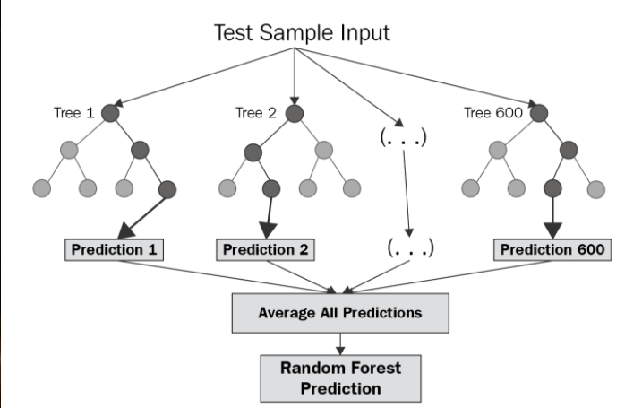
Modelling
Random Forest Regression :
Gives more accurate prediction than adabooster.
It is available in sklearn library.

Slide 12
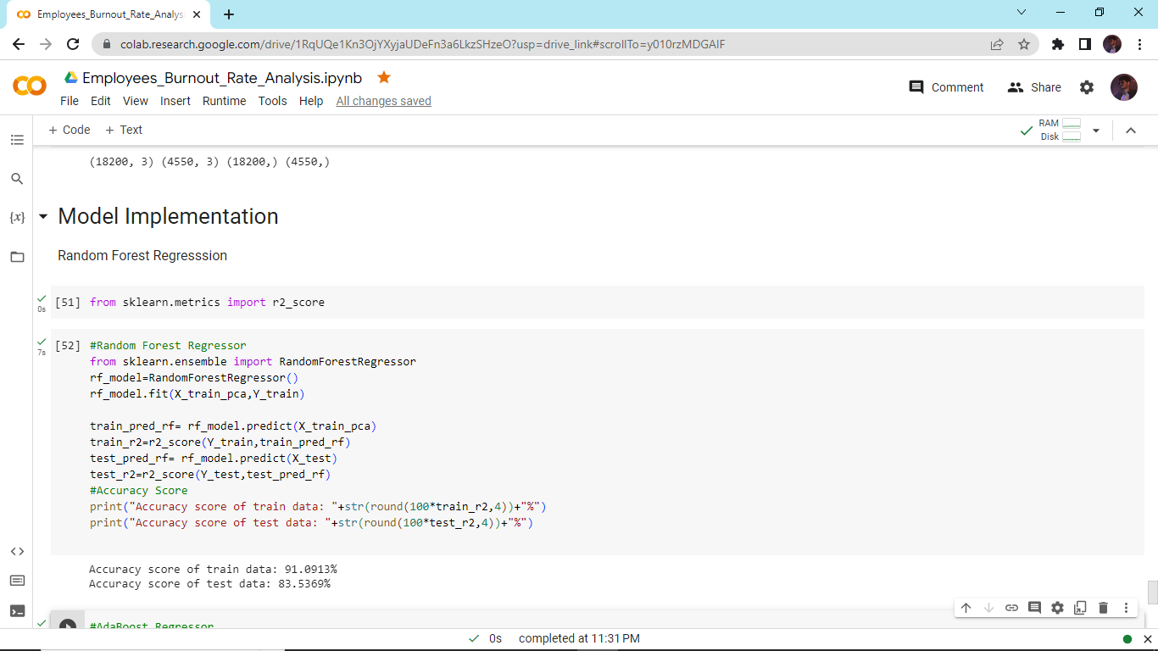
Results

Slide 13
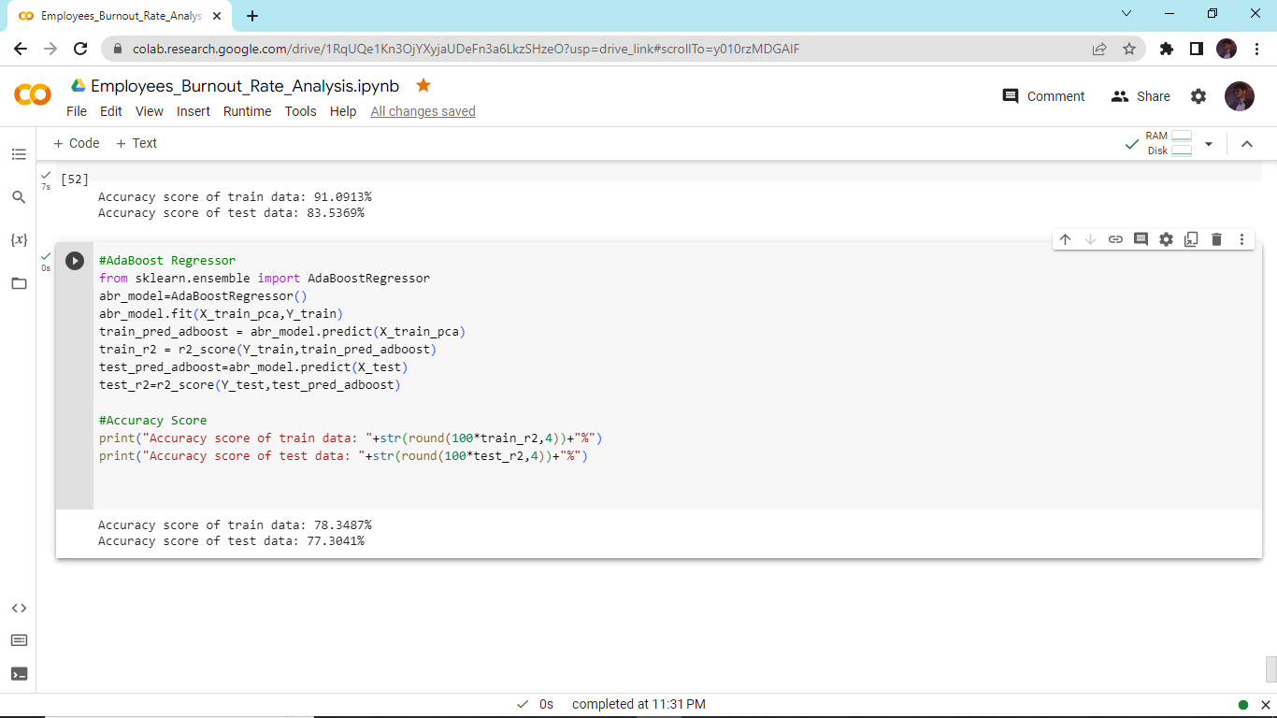
Results

Slide 14
Links
Employees_Burnout_Rate_Analysis.ipynb:
https://colab.research.google.com/drive/1RqUQe1Kn3OjYXyjaUDeFn3a6LkzSHzeO?usp=drive_link
Dataset Used :
https://docs.google.com/spreadsheets/d/1JErAl_CLnxDtCBfsAx6gHritlLqYM29o/edit?usp=drive_link&ouid=115196068006025088994&rtpof=true&sd=true

